Slide 1
Different Ways to Detect Outliers Explained for Beginners
What is Outlier?
Reasons?
Different Methods
Let’s do some practice using python!
Sajjad Mustafa

Slide 2
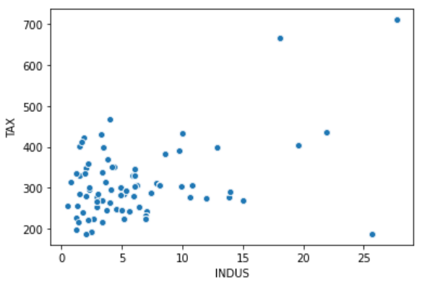
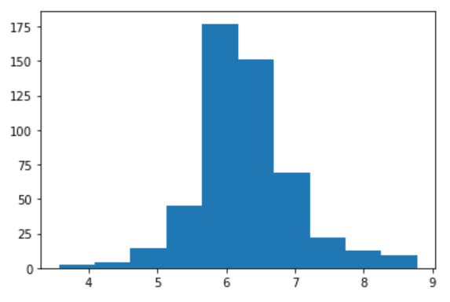
Definition
Outliers are samples that are exceptionally far from the mainstream of the data.
Outliers

Slide 3
Measurement or input error.
Data corruption.
True outlier observation (e.g. Bill Gates in income).
Reasons

Slide 4
Domain Knowledge
Age can never be negative
Statistical Methods
Standard Deviation/z-score
Interquartile Range(IQR)
Methods

Slide 5
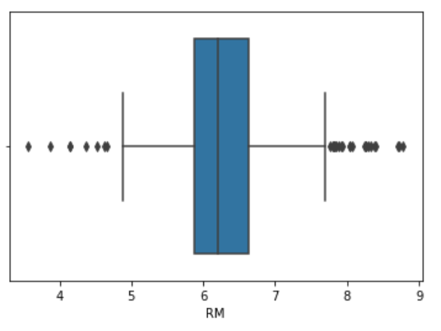
IQR
Q1
Q3
Median
Minimum Boundary (Q1 – 1.5*IQR)
Maximum Boundary (Q3 + 1.5*IQR)

Slide 6
Practice
Let’s go to jupyter notebook

Slide 7
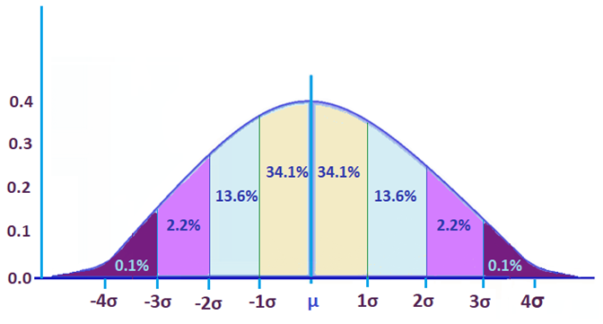
Standard Deviation
1 Standard Deviation from the Mean: 68%
2 Standard Deviations from the Mean: 95%
3 Standard Deviations from the Mean: 99.7%

Slide 8
Practice
Let’s go to jupyter notebook

Slide 9
Different ways
to
remove/replace
outliers
What Next?

Slide 10
Website : www.aisciences.io

